Slide 1

MRA Project-2 Grocery Store's Data
Submitted by: Atul Yadav
Batch: PGP DSBA Feb23.B G3

Slide 2
Agenda
Executive Summary of the data
Exploratory Data Analysis
Market Basket Analysis
Associations Identified
Recommendation

Slide 3
Executive Summary
Data: from 01-01-2018 to 26-02-2020
Objective: Project involves conducting a thorough analysis of Point of Sale (POS) data for providing recommendations through which a grocery store can increase its revenue by popular combo offers & discounts for customers.
Dataset: 20641 Rows, 3 columns,
Missing values : None
Duplicate values: 4730
The exploratory analysis and insights provide a clear understanding of the data and highlight the key trend and pattern in sales.
Market Basket Analysis using association rules was performed to identify the relationships between the products purchased by the customers.
This analysis helped to identify the products that are frequently purchased together, which can be used to create lucrative offers for the customers.

Slide 4
Contents
Executive Summary of the data
Problem statement
Executive Summary & Data Dictionary
Assumptions about data
Exploratory Analysis & Insights
Weekly, Monthly, Quarterly, Yearly, Weekday Trends in Sales count
Products counts & Year Wise top products
Summary and Recommendations
Market Basket Analysis
Market Basket Analysis Meaning
MRA KNIME WorkFlow & Qutput Table
Associations Identified
Association Rule Parameters
MRA – values
Association Rules Table
Recommendation

Slide 5
Problem Statement
An automobile parts manufacturing company has collected data on transactions for 3 years. They do not have any in-house data science team, thus they have hired you as their consultant. Your job is to use your data science skills to find the underlying buying patterns of the customers, provide the company with suitable insights about their customers, and recommend customized marketing strategies for different segments of customers.

Slide 6



Data Dictionary
1
Date:
Date at which product was sold
2
Order_id:
Invoice no. of the order or Customer ID
3
Product:
Name of the sold product

Slide 7
Assumptions
The data represents a list of items purchased at a grocery store on various dates.
Each entry in the data represents a single item purchased.
The first column in the data represents the date on which the item was purchased.
The second column represents either the Invoice no./ customer ID who made the purchase.
The third column represents the item purchased.
The same item can be purchased by multiple customers on different dates.
There is no information provided about the quantity or price of each item.
We have not dropped the duplicated values.

Slide 8
Exploratory Data Analysis
Quarterly, Yearly, Monthly, Weekday Trends in Sales count
Products counts & Year Wise top products
Summary and Recommendations

Slide 9
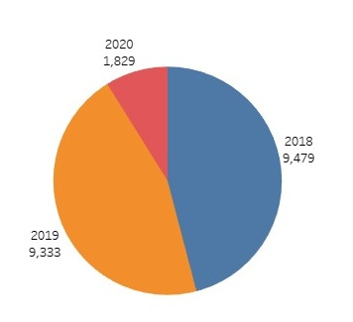
Yearly Count of Products Sold
As we have data till Feb 2020, that’s why the count of products sold in 2020 is low.
There is no major difference is order count on yearly basis

Slide 10
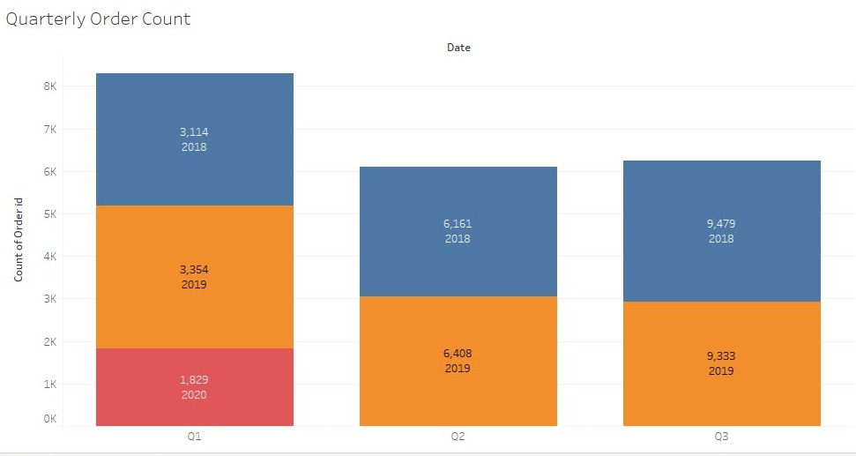
Quarterly Count of Products Sold
Q1 has highest order contribution, as data is till Feb 2020
Whereas on yearly comparison, Q1 has lowest order every year.

Slide 11
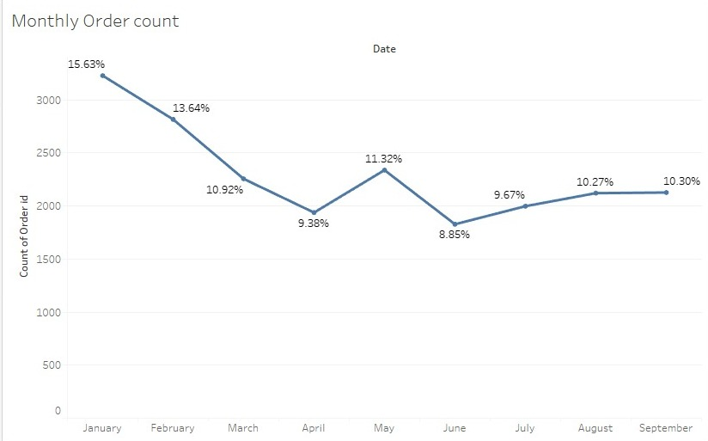
Monthly Count of Products Sold
We can observe a downward trend line in monthly order count, mainly because of incomplete data for 2020.

Slide 12
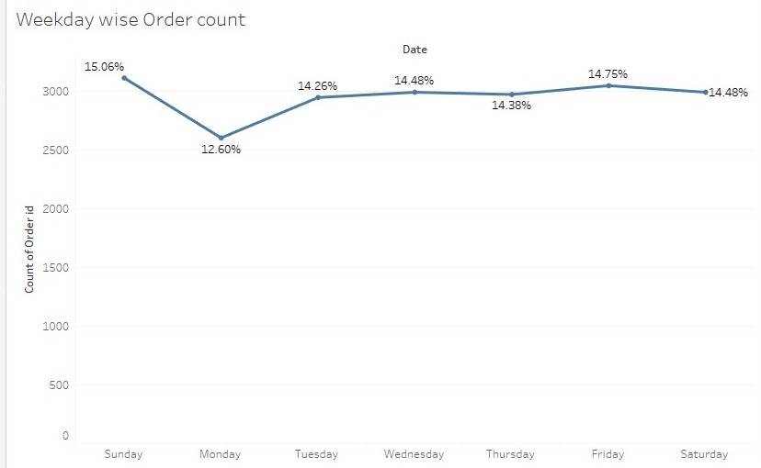
Weekday Count of Products Sold
As expected, Sunday has the highest order quantity.
Whereasas, Monday has the lowest order quantity

Slide 13
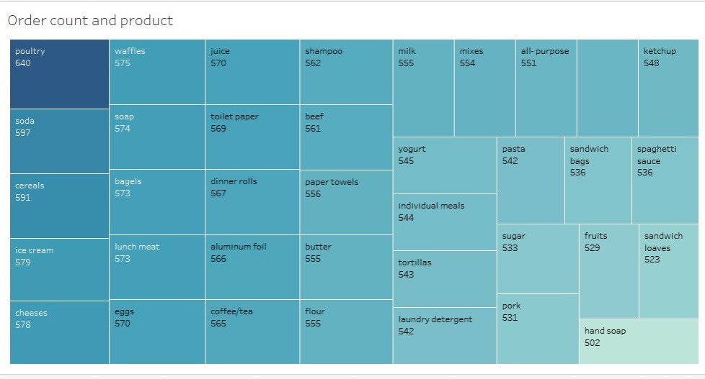
Count of Products Sold
Poultry, soda and cereals are top 3 order contributor in overall category.
Hand soap, sandwich loaves and fruits are bottom 3 order contributor

Slide 14
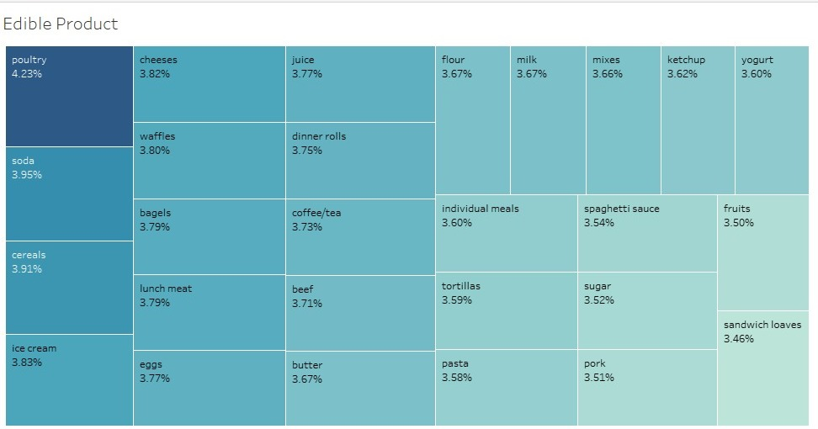
Count of Edible Products Sold:
Poultry, soda and cereals are top 3 order contributor in edible products category.
Sandwich loaves, fruits and pork are bottom 3 order contributor

Slide 15
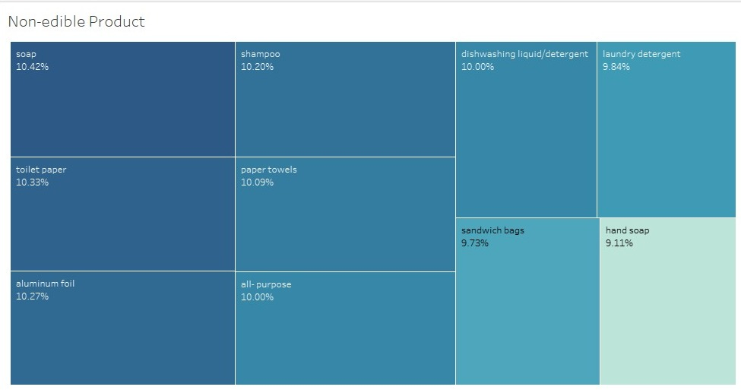
Count of Non-edible Products Sold:
Soap, toilet paper and aluminum foil are highest contributor in nonedible product category.
There is no major difference in contribution of all products here.

Slide 16
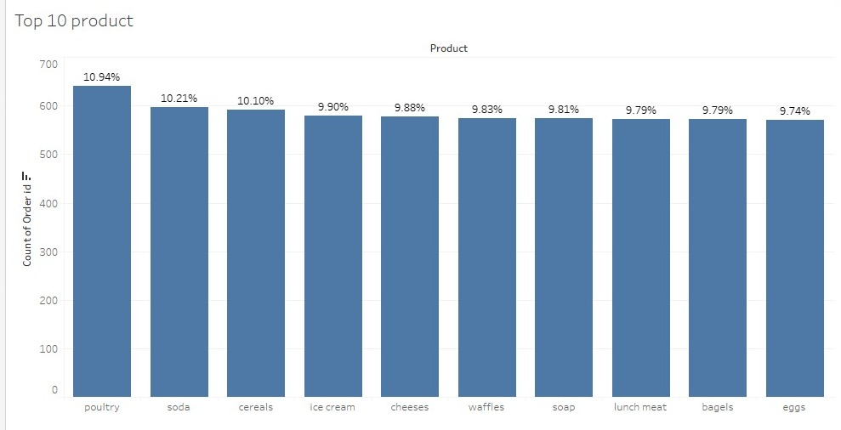
Top ten products over the years
These are the top 10 products as per order quantity

Slide 17
Summary
Poultry, Soda and Cereals are the highly sold products over the years. All top 6 products are edible products
The highest sold products are Soap and Toilet Paper, and the lowest sold product is Hand Soap in non edible products.
The highest sold products in the edible category are Poultry, Soda, and Cereals, and the least sold products are Pork, Fruits, and Sandwich Loaves.
Most of the products were sold on Sundays, and the least were sold on Mondays.
In 2018, the most products were sold in January, and the least were sold in February. In 2019, the most products were sold in March, and the least were sold in January.
The sales were the highest in Q1 2019 and Q3 2018.
The count of products sold in Q2 is approximately the same in 2019 and 2018.
The count of products sold in 2020 is low, possibly due to the data being only until 26th February.

Slide 18
Recommendation
Focus on promoting and stocking up on poultry, soda, and cereals as they are consistently top-selling products.
Consider increasing the stock of soap and toilet paper as they are the highest sold non-eatable products.
Evaluate the reasons behind the low sales of hand soap and take measures to increase its sales.
Schedule promotions and offers on Sundays to maximize sales on the day with the highest sales.
Plan marketing campaigns and discounts during February to increase sales during the historically low-sales month.
Plan marketing campaigns and discounts during January and March to increase sales during the historically high-sales months.
Aim to replicate the sales patterns of Q1 2019 and Q3 2018.
Keep the stock of products sold in Q2 consistent with the previous years to maintain sales levels.
Keep in mind the limited data for 2020 while making sales and marketing decisions.

Slide 19
Market Basket Analysis
Market Basket Analysis Meaning​
MRA KNIME WorkFlow & Qutput Table

Slide 20
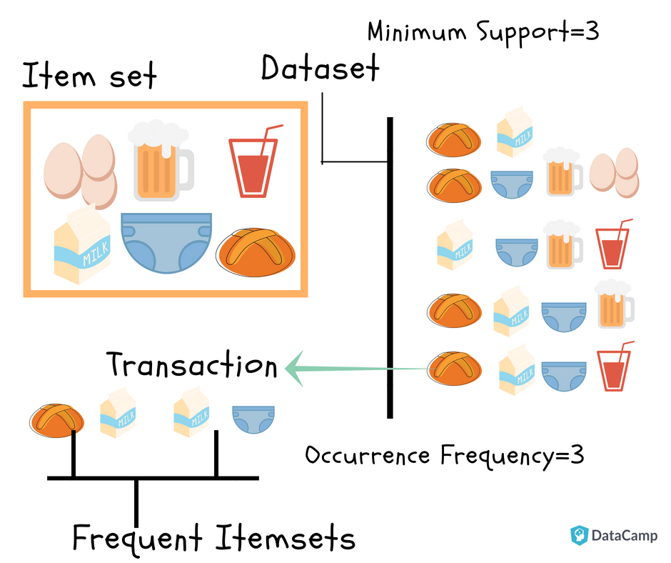
Market Basket Analysis
Definition: Market Basket Analysis is a statistical technique that analyzes customer purchase patterns to identify associations between different products. It helps businesses understand which products are frequently purchased together and how customers' buying habits affect sales.
Data: To conduct market basket analysis, businesses need transactional data that includes details such as customer ID, product ID, and transaction date. This data is then used to create a matrix that represents the relationships between different products.
Association Rules: Association rules are used to identify the strength of the relationship between different products. These rules are expressed in terms of support, confidence, and lift. Support refers to the frequency of co-occurrence of items in a transaction, while confidence measures the probability that if a customer buys one item, they will also buy another. Lift measures the degree of correlation between two items.

Slide 21
Market basket analysis, support, confidence, and lift values
In market basket analysis, support, confidence, and lift values are used to measure the strength of association between items in a transaction dataset.
Support: It is the probability of observing the items together in a transaction. It is calculated as the number of transactions that contain both items divided by the total number of transactions. It measures how frequent the itemset occurs in the dataset. High support indicates that the itemset is popular and should be considered for promotion or placement together.
Confidence: It is the conditional probability that a transaction containing one item also contains another item. It is calculated as the number of transactions containing both items divided by the number of transactions containing the first item. It measures the strength of the association between two items. High confidence indicates that the items are likely to be bought together, and can be used to recommend or suggest items to customers.
Lift: It is the measure of how much more often two items occur together than expected if they were independent of each other. It is calculated as the support of the itemset divided by the product of the individual supports of the items. A lift value of 1 indicates that the items are independent, while a value greater than 1 indicates a positive association between the items. A lift value less than 1 indicates a negative association between the items. High lift indicates that the items have a strong association and can be used for cross-selling or bundling.

Slide 22
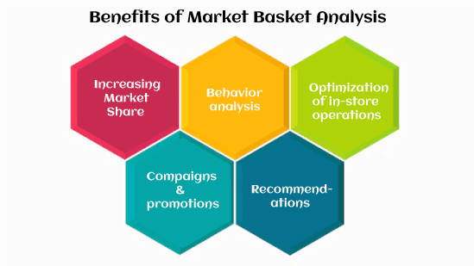
Market Basket Analysis
Applications: Market Basket Analysis is used in a variety of industries, including retail, e-commerce, and marketing. Retailers use this technique to optimize product placement and promotions. E-commerce companies use it to personalize product recommendations, and marketers use it to develop targeted advertising campaigns.
Benefits: Market Basket Analysis helps businesses increase revenue by identifying cross-selling opportunities and developing targeted promotions. It also helps improve customer satisfaction by providing personalized recommendations and improving the overall shopping experience

Slide 23
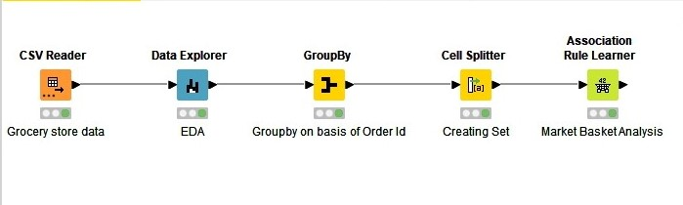
MRA KNIME Workflow

Slide 24
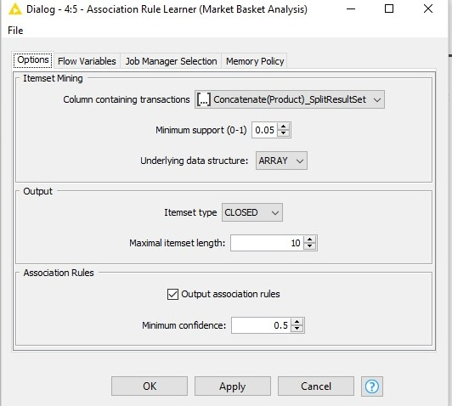
Association Rule Parameters
Support of Minimum: 0.05
Maximum Item Set Length : 10
Minimum Confidence Level: 0.5

Slide 25
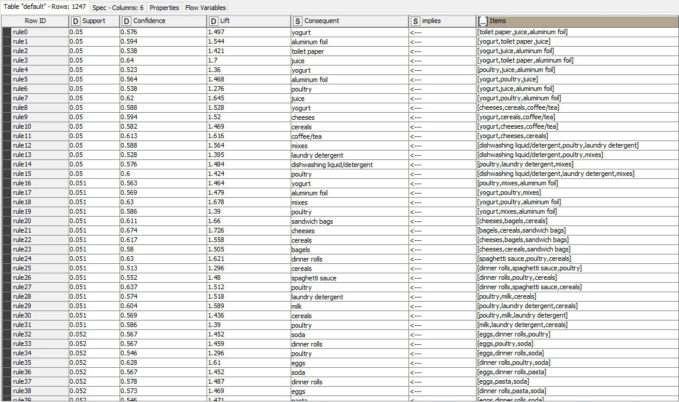
Association Rules
Association rules are a technique used to find relationships or associations between items in a large dataset. These rules are based on the concept of frequent itemsets, which are sets of items that appear together frequently in a transactional dataset.
1247 rules have been found with the dataset and set parameters.

Slide 26
Recommendations
Offer a "Buy Two Get One Free" promotion on yogurt, juice, and aluminum foil to encourage customers to purchase more items at once.
Create a combo deal where customers can purchase yogurt, poultry, and juice together at a discounted price.
Offer a discount on mixes when purchased with yogurt, poultry, or aluminum foil.
Provide a discount on dinner rolls when purchased with poultry.
Create a "Paper Products Bundle" offer that includes paper towels, toilet paper, and/or tissues at a discounted price.
These discount offers and combos can help increase sales by providing customers with more value for their money and encouraging them to purchase more items. It is important to promote these offers through in-store signage, advertisements, and social media to ensure customers are aware of the deals available.

Slide 27
Summary
The analysis identified the products that are often purchased together by customers, which can help the store to optimize its product placement and promotions.
Yogurt, poultry, aluminum foil, cheeses, cereals, and dinner rolls are some of the most frequently purchased products.
Some of the product associations are unexpected, such as poultry with dishwashing liquid/detergent, laundry detergent, and mixes.
The analysis suggests that offering discounts or combos, such as "buy two get one free," on certain products can encourage customers to purchase more.
The store can also consider placing complementary products in close proximity to each other to increase the likelihood of customers making additional purchases.
Overall, the market basket analysis can help the store to better understand customer behavior and preferences, and to make informed decisions about product placement and promotions.

Slide 28
THANK YOU

